Slide 1
Mansfield Analysis
Louis Rafter

Slide 2
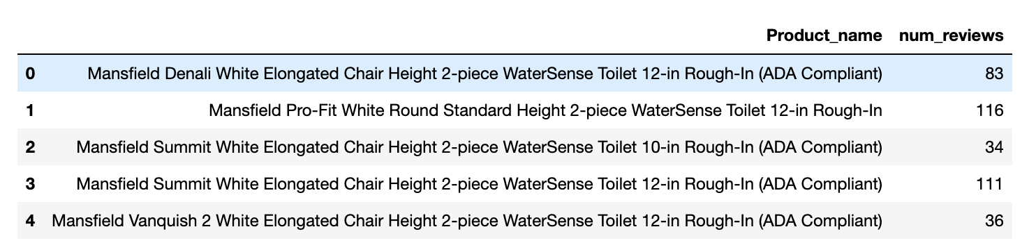
Introduction - Mansfield Reviews
We are analyzing the reviews of 5 products listed below.
The main goal is to understand the sentiment behind the reviews.

Slide 3
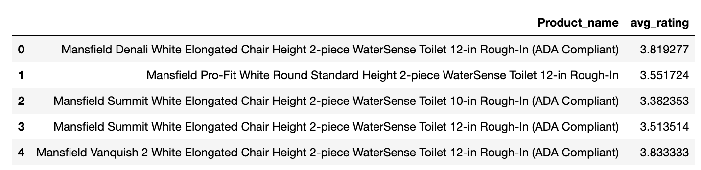
Exploratory Analysis
To understand the data first we perform an exploratory analysis.
We look at the data, any null values that may be present, and the average rating of the products.

Slide 4
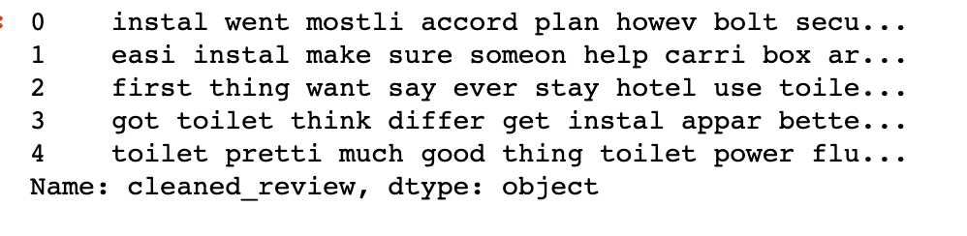
Text Preprocessing
Then we use NLTK to remove stopwords, perform lemmatization and stemming on the text.
The purpose of this is to clean the data so that the words that are left are valuable.
Text below shows how words are reverted to their stem. Words like install and installation have the same stem so they will be shown as instal.

Slide 5
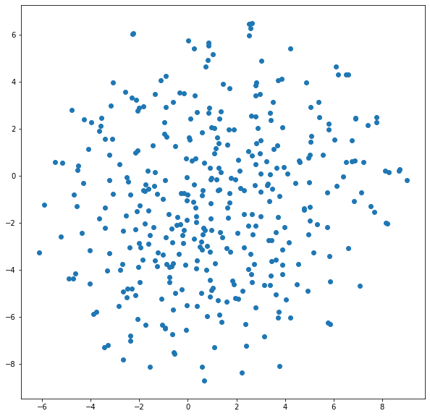
Word Embeddings Using Word2Vec
Word embeddings are a way to represent text in a numerical format that can be used in machine learning models.
The embeddings are created by analyzing the context in which words appear in a large corpus of text.
The resulting vectors have properties that allow them to capture the meaning of words and their relationships to other words in the corpus.
Visualizing the embeddings can provide insight into the relationships between words and how they are used in context.
Scatter plots are a common way to visualize embeddings, with each point representing a word and their distance from each other indicating their similarity.

Slide 6
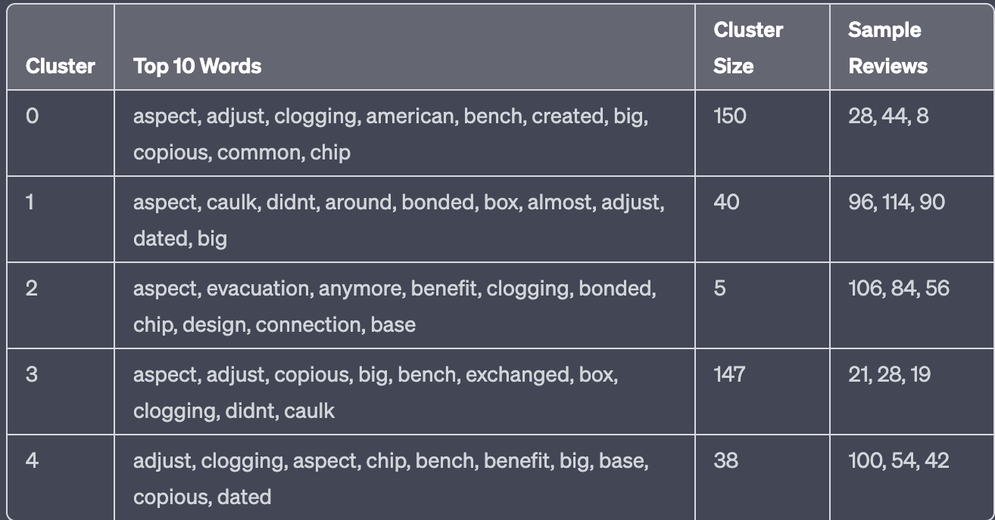
Clustering
Clustering can be a useful technique for analyzing large volumes of customer reviews and identifying common themes or issues that can inform product development and marketing strategies.
The table on the right shows that the reviews have been grouped into 5 clusters, showing the top ten words in each, the size of each and some sample reviews that are within those clusters.
Based on this output it is hard to determine specific themes.

Slide 7
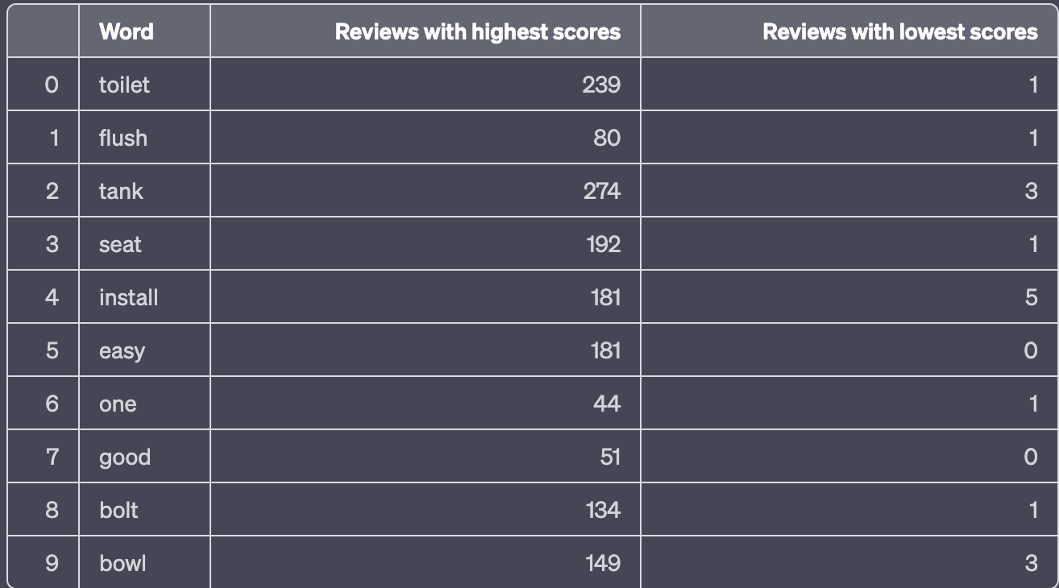
Word Embeddings Using TF-IDF
Statistical technique used to evaluate the importance of words in a corpus
Each word is assigned a weight based on its’ frequency
Helps identify which words are most relevant and informative
The table shows the top ten words with the highest scores
For each word it shows the reviews with the highest and lowest scores, this indicates the importance of the word.

Slide 8
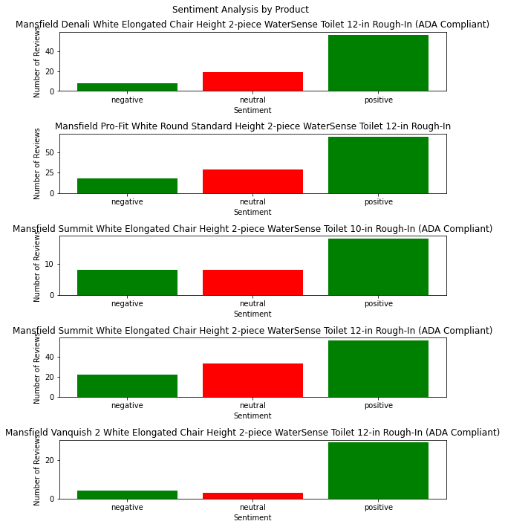
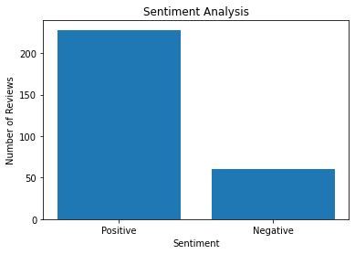
Sentiment Analysis
Since clustering wasn’t a strong indicator of the themes throughout the reviews, we perform a sentiment analysis using Vader.
This will separate the reviews into positive and negative reviews, which will allow us to determine trends throughout the reviews.

Slide 9
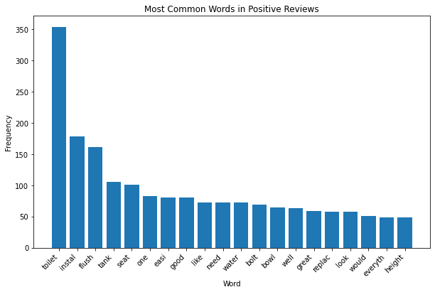
Positive Reviews

Slide 10
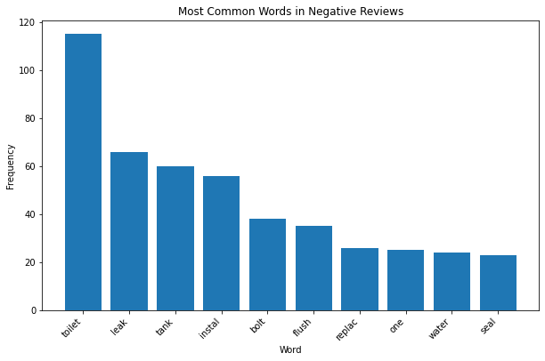
Negative Reviews

Slide 11
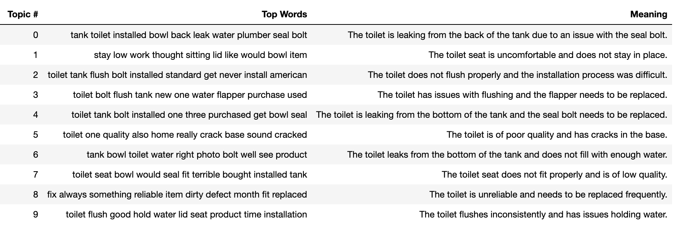
Common Complaints
We are able to separate the reviews into topics.
The reviews below are the top most common negative reviews with their meanings.

Slide 12
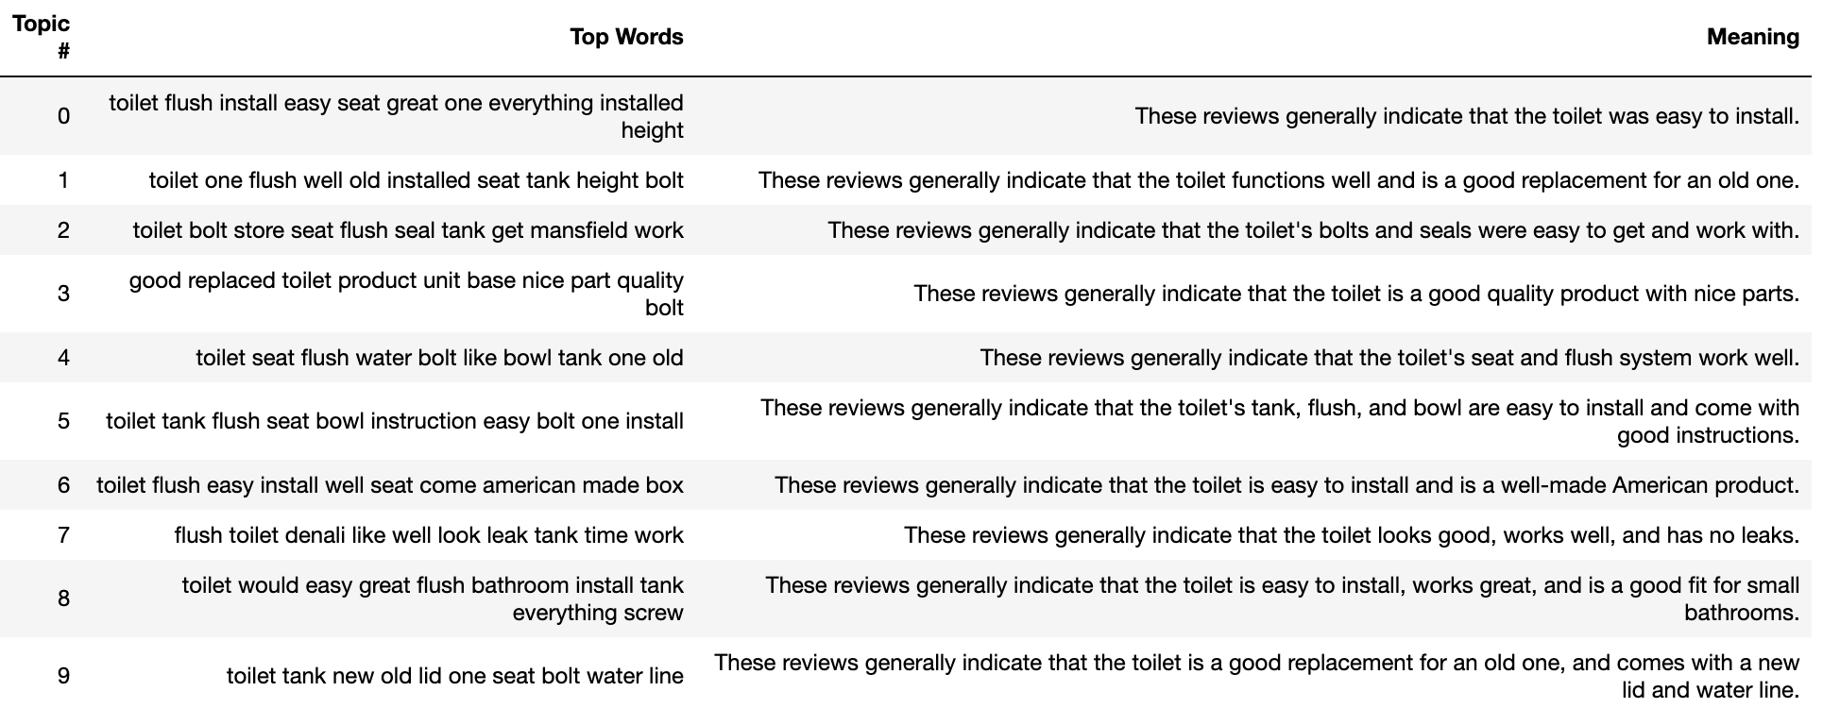
Common Positive Reviews
We can also look at the top ten most common positive reviews.

